Slide 1
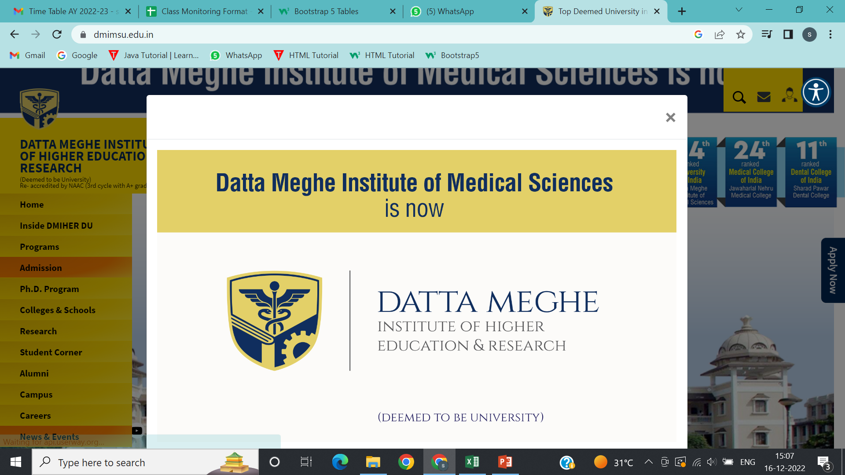
SCHOOL OF ALLIED SCIENCES Faculty of Science and Technology “Breakdown Buddy”

Slide 2

DATTA MEGHE INSTITUTE OF HIGHER EDUCATION AND RESEARCH (DEEMED TO BE UNIVERSITY) SCHOOL OF ALLIED SCIENCES FACULTY OF SCIENCE & TECHNOLOGY Sawangi (Meghe), Wardha – 442107, Maharashtra
“Breakdown Buddy”
Project Guide :-
Prof. Kalyani Satone
MCA I SEM IV :- 39355 Gauri M. Gundawar

Slide 3
Introduction of Project
Breakdown Buddy is going to be a good solution for the people who seek help in the remote locations with mechanical issues of their vehicle.
Users of the On Road Vehicle Breakdown Assistance will be the registered public and they be getting details of the the particular mechanics through the Breakdown Buddy system.
The app provides a user-friendly platform that helps users directly find mechanics, ensuring quick and efficient support during vehicle breakdowns.
School of Allied Sciences, Faculty of Science and Technology

Slide 4
Existing System
In the existing system there are users who have their own mechanic database which is very minimal .Users with the contacts of people at the particular place may look for a help from them only if they are ready to do.
It is not possible to find out the suitable mechanic for the desired service at remote locations. User needs to gather the mechanic related information from friends or people around the spot .
It increases the human work and user could not easily identify the mechanic details and get help from that workshop
School of Allied Sciences, Faculty of Science and Technology

Slide 5
Need for System
The need for this app arises from the common challenges and inconveniences faced by motorists during unexpected breakdowns.
Accessing reliable mechanics is often limited, and user may not be able to find them immediately.
Therefore, this app is essential to bridge this gap and provide immediate and efficient support to users in need.
To prevent inconvenience for users
School of Allied Sciences, Faculty of Science and Technology

Slide 6
Operating Environment – Hardware and Software
Operating environment
Operating system : Android
Front end : XML
Back end : MySQL, database
School of Allied Sciences, Faculty of Science and Technology

Slide 7
Objectives of Proposed System
To overcome the problems by utilizing a dedicated app or platform that can help for breakdown assistance.
To provide a user-friendly interface, making it easy for users to navigate and find assistance effortlessly.
Minimize inconvenience caused by breakdowns through quick access to reliable mechanics.
School of Allied Sciences, Faculty of Science and Technology

Slide 8
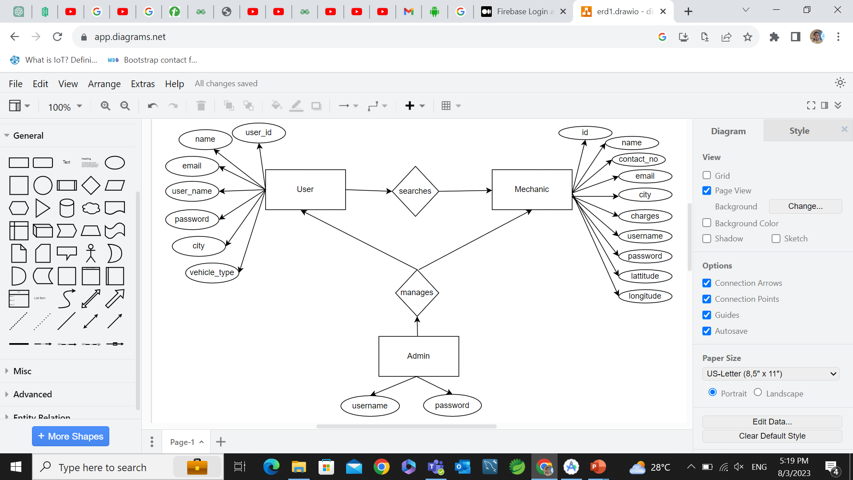
Entity Relationship Diagram
Fig. ER-diagram
School of Allied Sciences, Faculty of Science and Technology

Slide 9
Module Specification
Breakdown Buddy
Admin
User
Mechanic
Fig. module specification diagram
School of Allied Sciences, Faculty of Science and Technology

Slide 10
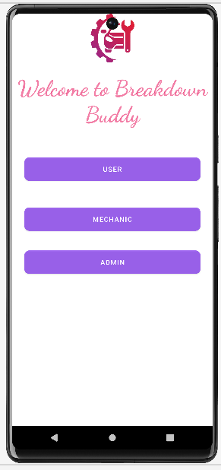
Data Flow Diagrams
School of Allied Sciences, Faculty of Science and Technology

Slide 11
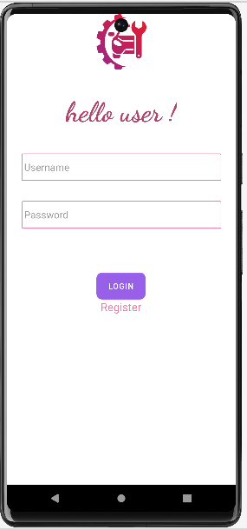

Slide 12
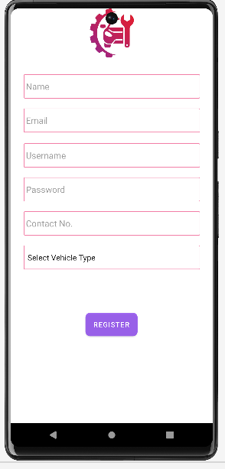

Slide 13


Slide 14
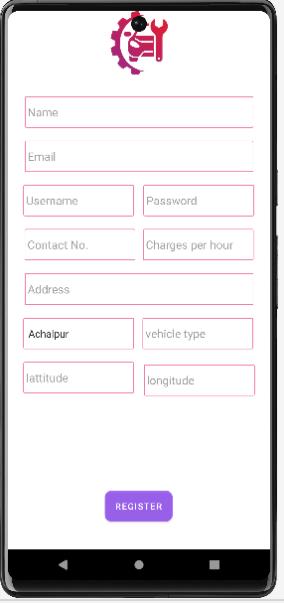

Slide 15
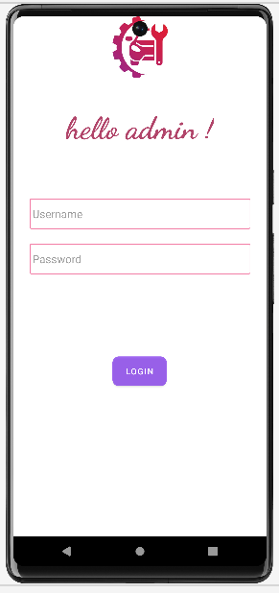

Slide 16
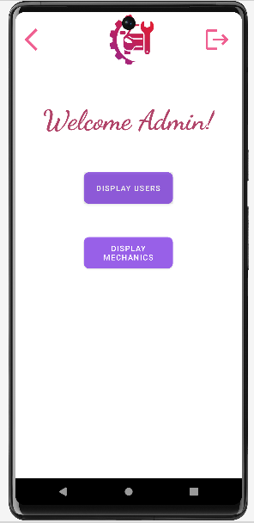

Slide 18
Activity Diagrams
School of Allied Sciences, Faculty of Science and Technology

Slide 19
Sequence Diagrams
School of Allied Sciences, Faculty of Science and Technology

Slide 20
Usecase / UML Diagram
School of Allied Sciences, Faculty of Science and Technology

Slide 21
Table Specification
tbl_users
Column name | Data_type | Size | Constraint_key
mech_id | Int | 10 | Primary key
Name | varchar | 50 | Not null
Contact_no | int | 10 | Not null
Email | Varchar | 50 | Not null
Vehicle_type | Varchar | 30 | Not null
Username | Varchar | 50 | Not null
password | Varchar | 50 | Not null

Slide 22
tbl_mech
Column name | Data_type | Size | Constraint_key
User_id | int | 10 | Primary key
Name | varchar | 50 | Not null
Contact_no | int | 10 | Not null
Email | Varchar | 50 | Not null
Vehicle_type | Varchar | 50 | Not null
City | Varchar | 50 | Not null
Charges | int | 20 | Not null
Address | Varchar | 50 | Not null
Username | Varchar | 50 | Not null
Password | Varchar | 50 | Not null
Latitude | Double | 50 | Not null
longitude | Double | 50 | Not null

Slide 23
User Interface Design
School of Allied Sciences, Faculty of Science and Technology

Slide 24
Operational / Menu Explanation
Cdcsccs dfddsfdsfdsf dvdsfdfdf
School of Allied Sciences, Faculty of Science and Technology

Slide 25
Program specification / Flowcharts
School of Allied Sciences, Faculty of Science and Technology

Slide 26
Conclusion
Fdafdfdf
Hgfdghfdgh
Dvdv
Dfdsgd
Fdfdsff
dsdsdd
School of Allied Sciences, Faculty of Science and Technology

Slide 27
Future Enhancements
The following section describe the work that will be impleamnted with future releases of software.
Ffgfgfg
Gdsgsdgsdg
Gdfdfsf
fdfdsfvdv
School of Allied Sciences, Faculty of Science and Technology

Slide 28
Bibliography
Gfgg
Fdfdfd
Ffdf
Fsfsf
Fssffs
fsfssf
School of Allied Sciences, Faculty of Science and Technology

